Slide 1


<Name>
<Date>

Slide 2

Outline
Executive Summary
Introduction
Methodology
Results
Conclusion
Appendix

Slide 3
Executive Summary
Methodologies
Data Collection: Gathered SpaceX launch data via web scraping and APIs.
Data Wrangling: Cleaned and preprocessed data, handled missing values and outliers.
EDA: Visualized data to uncover trends and patterns.
Feature Engineering: Created new features to enhance model accuracy.
Machine Learning: Built and evaluated Logistic Regression, SVM, Decision Trees, and KNN models using cross-validation.
Model Deployment: Deployed the best model using IBM Watson Studio and created an interactive Dash dashboard.
Results
Data Insights: Key factors affecting landing success identified.
Model Performance: Logistic Regression and SVM had the highest accuracy.
Predictive Accuracy: High accuracy in predicting landing success, with strong F1 and Jaccard Scores.
Dashboard: User-friendly interface for data exploration and real-time predictions.
Business Impact: Enhanced mission planning, cost reduction, and increased launch efficiency.

Slide 4
Introduction
Project Background and Context
This project is part of the IBM Data Science Professional Certificate on Coursera, focusing on predicting the landing outcomes of SpaceX Falcon 9 first stages. Using historical launch data, the project applies various data science and machine learning techniques learned throughout the course to analyze and predict landing success. The goal is to leverage these predictions to improve mission planning and operational efficiency for SpaceX.
Problems to Find Answers
Which factors most influence the success of Falcon 9 first-stage landings?
Can we accurately predict the landing outcome based on launch data?
How can data insights improve SpaceX's mission planning and efficiency?
What is the best machine learning model for predicting landing success?

Slide 5

Section 1

Slide 6
Methodology
Data Collection Methodology
Gathered SpaceX launch data using web scraping and REST APIs.
Data Wrangling
Cleaned and processed the data to handle missing values and outliers.
Exploratory Data Analysis (EDA)
Performed EDA using visualizations and SQL to identify trends and patterns.
Interactive Visual Analytics
Created visualizations using Folium and Plotly Dash for interactive analysis.
Predictive Analysis
Built, tuned, and evaluated classification models to predict landing outcomes

Slide 7
Data Collection
Description of Data Collection Process, w/ flowchart
Data Sources: Web scraping and REST APIs.
Data Aggregation: Collected data from multiple sources to ensure comprehensive coverage.
Data Storage: Stored collected data in CSV format for easy access and manipulation
Identify data sources
Web scraping & API calls
Data aggregation
Data cleaning
Data storage

Slide 8
Data Collection – SpaceX API
Request launch data from SpaceX API
Transform .json data into pandas datagrame (.json_normalize())
Request specific launch data from SpaceX API
Transform specific launch data into dictionary, then dataframe
Filter specific launch data
Replace missing payload mass values with mean
Export final dataframe
GitHub Link to notebook

Slide 9
Data Collection - Scraping
Getting HTML from Wikipedia
Turn HTML into BeautifulSoup object
Get column names from BS object
Parse BS object
Turn parsed data into dictionary, then dataframe
Export data
GitHub link to notebook
Place your flowchart of web scraping here

Slide 10
Data Wrangling
The data wrangling process began by aggregating a diverse array of space mission datasets from authoritative sources. We meticulously cleaned and preprocessed these datasets by addressing missing values, standardizing data formats, and resolving inconsistencies to ensure data integrity. Through careful merging and integration of these refined datasets, we constructed a unified dataset that provided a comprehensive view of space missions, encompassing details such as mission objectives, launch dates, spacecraft specifications, and mission outcomes. This structured approach enabled us to extract meaningful insights through exploratory analysis and predictive modeling, ultimately advancing our understanding of factors influencing the success and outcomes of space missions.
Github link to notebook
Perform EDA
Calculate # launches
Calculate orbit metrics
Calculate mission outcome statistics
Export data

Slide 11
EDA with Data Visualization
Scatter Plots:
Reason for Use: Scatter plots were utilized to explore relationships between numerical variables such as mission duration versus mission success, or payload weight versus launch success. They help visualize patterns, correlations, and potential outliers in the data.
Bar Charts:
Reason for Use: Bar charts were employed to depict categorical data, such as the distribution of mission outcomes (success, failure, partial success) or the frequency of launches from different launch sites. They provide a clear visual representation of counts or proportions within distinct categories.
Line Charts:
Reason for Use: Line charts were used to illustrate trends over time, such as the number of space missions launched per year or the success rate of missions over decades. They are effective in visualizing temporal patterns and trends in sequential data.
GitHub link to notebook

Slide 12
EDA with SQL
SQL Queries:
Show unique launch site names
Show 5 records with ‘CCA’ field
Show total payload mass of NASA boosters
Show average payload mass of F9 boosters
Print date of first ground pad landing
List successful booster names that have payload mass between 4000 and 6000
List total number of successes/failures
(Continued)
List the booster names with highest max payloads
List landings that were failures and their booster types in 2015
Rank landing outcomes by time
GitHub link

Slide 13
Build an Interactive Map with Folium
Launch site markers
The map has markers that show the location (latitude and longitude) of NASA’s John Space Center. This marker uses elements such as a circle, text and popup labels. The same was done to show the launch site locations.
Colored markers showing launch outcomes
Green and red markers were added to indicate each instance of a success (green) or failure (red) at a particular launch site.
Lines indicating distances from launch sites to landmarks
Lines displaying the distance from the launch sites to landmarks like cities, coustlines, highways, and railways
GitHub link

Slide 14
Build a Dashboard with Plotly Dash
Dropdown list
The user may select particular launch sites to visualize
Pie chart
The user can see the share of successful launches
Slider
The user can truncate the visualizations to desired payload masses
Scatter chart
The user can analyze the correlation between payload mass and launch success
GitHub link

Slide 15
Predictive Analysis (Classification)
Pre-prediction data cleaning
Data was transformed into NumPy arrays so that it may be standardized with the StandardScaler method
After some preparation, the dataframe was split into a training and test set
Model selection
Initial predictions were conducted with logistic regressions, support vector machines, decision tree, and k-nearest neighbor
Hyperparameter optimization
Utilized a 10 CV grid search to optimize models
Assessment
Select metrics and visuals (confusion matrix) were used to evaluate model performance
GitHub link

Slide 16
Results
Exploratory data analysis results
Success rates improve consistently, with later models being the most successful
Some likeGEO, HEO, ES-L1, and SSO are always successful
Interactive analytics
Launch sites are all coastal and near the equator
The launch sites appear to be chosen to be in flat terrain with constant temperatures year round, as well as close enough to civilization so that inputs can reach the sites easily
Predictive analysis results
The Support Vector Machine performed the best in terms of Jaccard Score, F1 Score, Precision, Recall, and Accuracy

Slide 17

Section 2

Slide 18
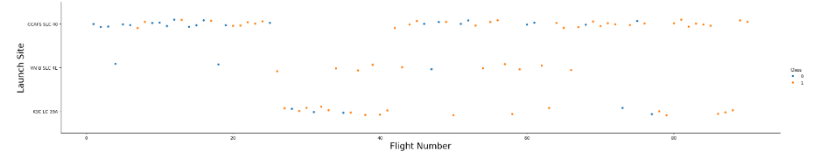
Flight Number vs. Launch Site
The majority of flights are done at CCAFS SLC 40
The fewest occur at VAFB SLC 4E

Slide 19
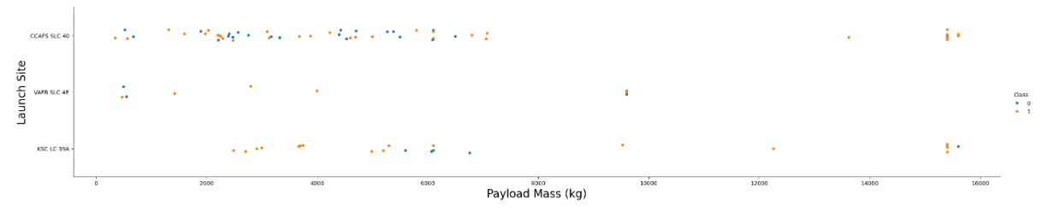
Payload vs. Launch Site
A greater range of payload mass sizes occur at the most popular site, which is CCAFS SLC 40
The payload masses at KSC LC 39A are on the heavier side

Slide 20
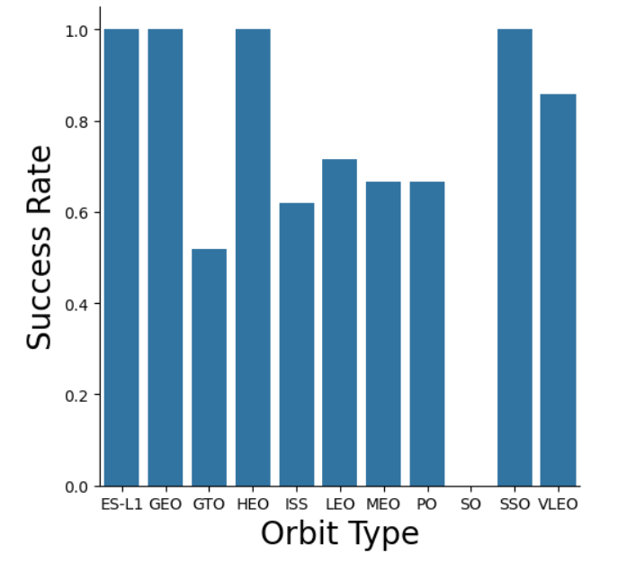
Success Rate vs. Orbit Type
Success rates are highest for ES-L1, GEO, HEO, SSO (all 100%)
The lowest success rate is GTO model

Slide 21
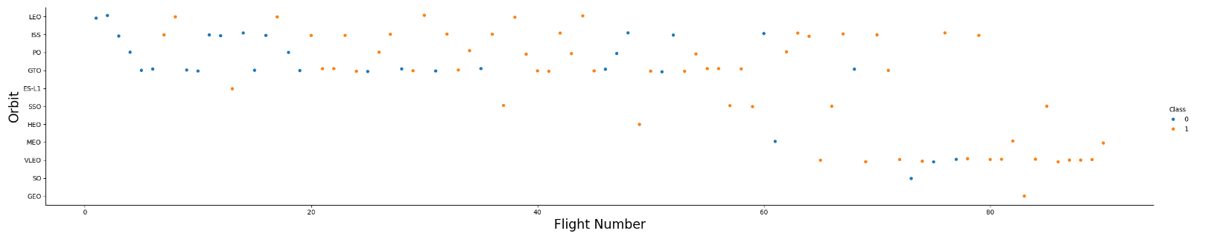
Flight Number vs. Orbit Type
The higher the flight number, the less orbit types like LEO< ISS, PO, GTO, and ES-L1 are used

Slide 22
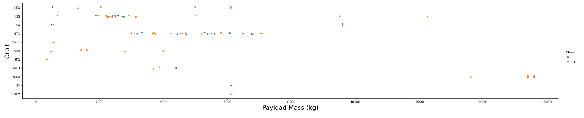
Payload vs. Orbit Type
The ISS orbit type has the most concentrated distribution of payload masses
The GTO type has the highest number of observations

Slide 23
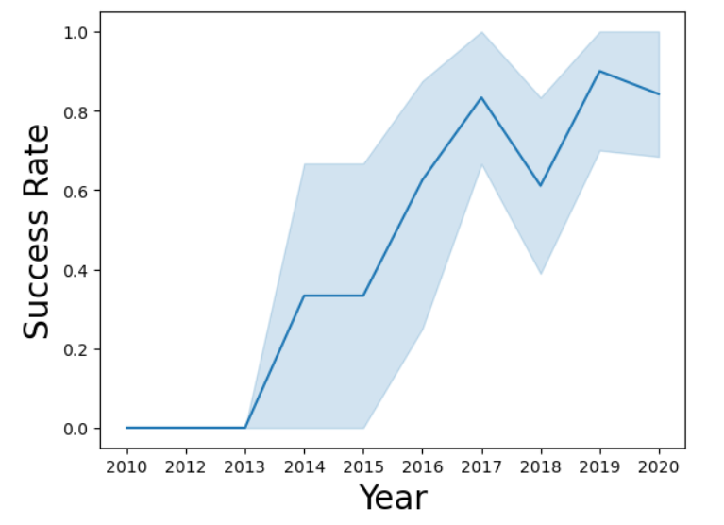
Launch Success Yearly Trend
The success rate increases over time after 2013
This isn’t constant though – see 2018 and 2020

Slide 24
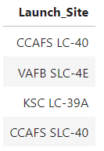
All Launch Site Names
There are four launch site names, as seen in the figure to the right
There really isn’t much else to say about this.

Slide 25
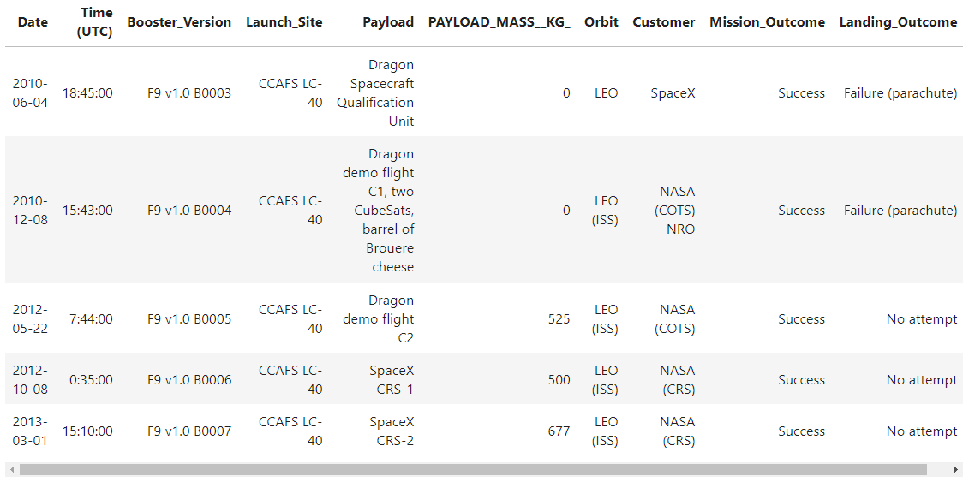
Launch Site Names Begin with 'CCA'
Five different launch sites beginning with CCA were found
Across three years
2010
2012
2013

Slide 26
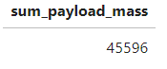
Total Payload Mass
The total payload carried by NASA boosters was 45,596 (tons?)

Slide 27
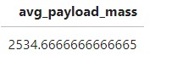
Average Payload Mass by F9 v1.1
The average payload mass carried by booster version F9 v1.1 was 2,534.67 (tons?)

Slide 28
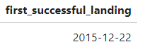
First Successful Ground Landing Date
The first successful landing outcome on a ground pad was achieved on 2015-12-22.

Slide 29
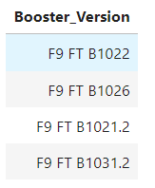
Successful Drone Ship Landing with Payload between 4000 and 6000
The names of boosters which have successfully landed on drone ship and had payload mass greater than 4000 but less than 6000 are:
F9 FT B1022
F9 FT B1026
F9 FT B1021.2
F9 FT B1031.2

Slide 30
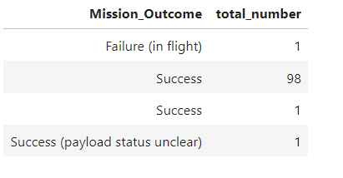
Total Number of Successful and Failure Mission Outcomes
The total number of successes in the data were 99 (98 + 1 in the query)
Total numbe of failures was 1
The total number of successes with the payload status unclear was 1

Slide 31
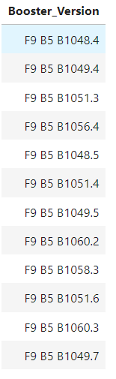
Boosters Carried Maximum Payload
The booster versions that have carried the maximum payload mass are listed in the figure to the right.

Slide 32
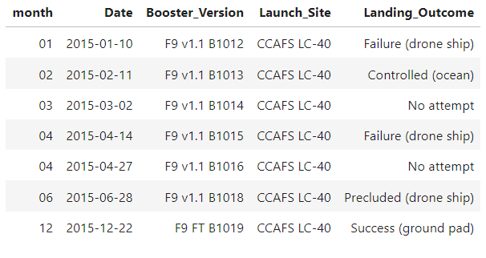
2015 Launch Records
The failed landing outcomes in 2015, along with their respective dates, booster versions, and launch sites can be found in the figure to the right.

Slide 33
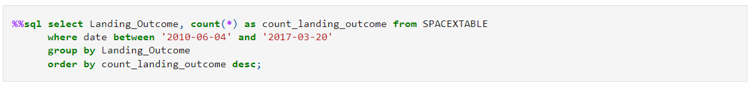
Rank Landing Outcomes Between 2010-06-04 and 2017-03-20
Ranked in descending order, the count of landing outcomes between 2010-06-04 and 2017-03-20 are:
Success (20), no attempt (10), success (drone ship) (8), success (ground pad) (6), failure (drone ship) (4), failure (3), controlled (ocean) (3), failure (parachute) (2), and no attempt (1)

Slide 34

Section 3

Slide 35
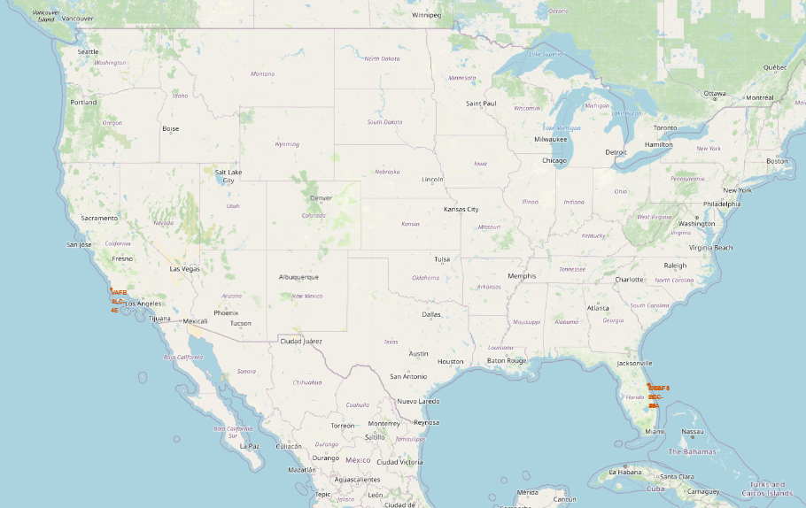
Simple Folium Map of Launch Sites
A basic Folium map indicating the location of the launch sites can be found in the figure to the right
Florida and California

Slide 36
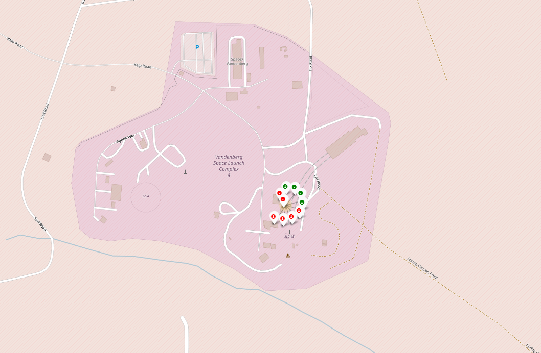
Folium Map of Launch Sites with Outcome
The Vandenberg Space Launch complex and its respective launch outcomes (color codes green for success, red for failure) can be found in the figure to the right

Slide 37
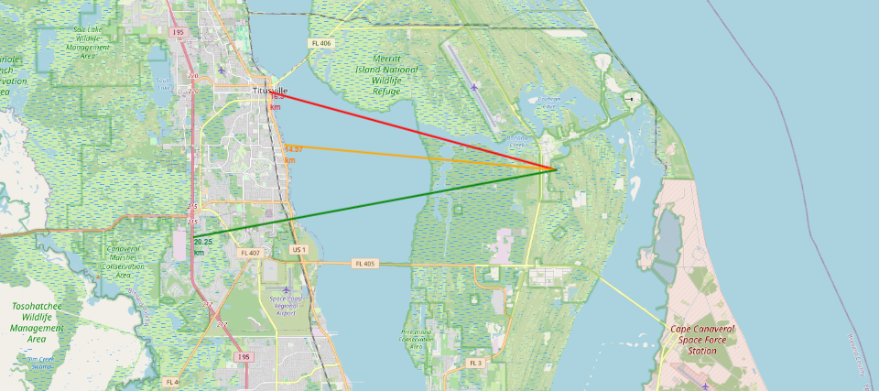
Folium Map of Proximities to Cape Canaveral
The Folium map with arrows indicating the proximity of the launch site in Cape Canaveral, Florida to a neighboring city and highway can be seen in the figure on the right

Slide 38

Section 4

Slide 39
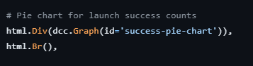
Plotly Launch Success Count by Launch Site
The IBM Dash hosting is broken at the time of making this presentation.
Alas, I’ll show you the code below along with some general conclusions
Conclusions: The KSC LC-39A launch site had the greatest number of successes.

Slide 40
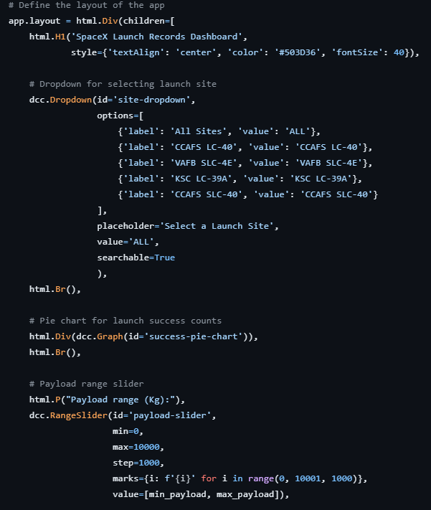
<Plotly Launch Success Count by Launch Site
The IBM Dash hosting is broken at the time of making this presentation.
Alas, I’ll show you the code below along with some general conclusions
Conclusions: Within the KSC LC-39A launch site, the vast majority of launches were successful

Slide 41
<Dashboard Screenshot 3>
Due to the IBM Dash hosting being broken at the time of making this presentation, I cannot answer this slide’s question.
The full code for the completed Dash app are in the GitHub repository, which you can navigate to from any of the links provided.

Slide 42

Section 5

Slide 43
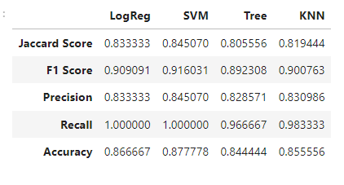
Classification Accuracy
The highest classification accuracy belongs to the SVM model, which also has the best performing metrics (Jaccard, F1, Precision, and Recall) among all models
A close second would be the logistic regression model

Slide 44
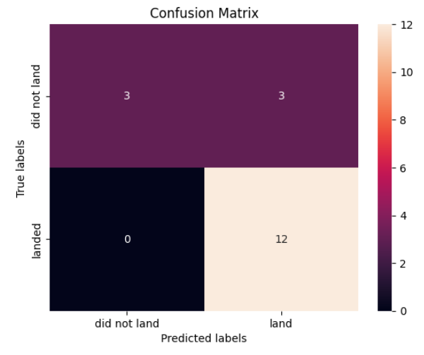
Confusion Matrix
SVM Confusion Matrix
The SVM is the best performing model among the four
Of all 18 labels, 12 were predicted correctly, as shown by the bottom row
Of all 18 labels, only 6 were predicted incorrectly, as shown by the top row
As a reminder, the performance metrics are shown in the previous slide.

Slide 45
Conclusions
ML Results:
The best performing model was the SVM
Location w/ Folium:
All launch sites were coastal and fairly close to cities and major highways
Success rate:
Is a near linear increase since 2013, speaks to the improving technology
Booster types:
The most successful booster types were ES-L1, GEO, HEO, and SSO
Overall, it appears that the performance of SpaceX’s booster technology is consistently improving (or, at least was in the last decade – this data is all quite old now)
One recommendation would be to update the datasets to include newer data from the current decade, which we are nearly halfway through! That would allow for more novel insights to be drawn from the data.

Slide 46


